Slide 1

Final Year Project
Midterm Presentation
AI‑Driven Quality Assistant for STLC Automation
Driving Intelligent Test Automation
Monika Tyagi, IISC, monikatyagi@iisc.ac.in

Slide 2
1. Problem Definition
Problem Statement & Motivation
Research Questions
2. Research Background
Related Work
Research Gap
Novelty
3. Proposed Framework
AI-Driven Multi-Agent Solution
Functional Overview
Benefits & Challenges
4. System Design & Demonstration
Architecture
Agentic Workflow
Demo
5. Future Work & Conclusion
Agenda

Slide 3
Problem Statement & Motivation
Fragmented and Manual STLC Processes
• STLC consists of multiple interconnected phases.
• Existing workflows rely on isolated tools and manual handoffs.
• Validation and traceability are inconsistent.
Why This Matters
• Faster releases demand higher automation.
• Current automation mainly targets test execution.
• Upstream and downstream QA activities remain manual.
Consequences
Coverage gaps
Late defect detection
Increased manual effort
Higher cost of quality
Slower releases
Research Motivation
Develop an AI-driven multi-agent framework that provides end-to-end STLC orchestration instead of point automation.

Slide 4
Research Questions
This work investigates the following research questions:
RQ1: Can a multi-agent AI framework coordinate the complete STLC instead of isolated automation?
RQ2: How can AI-generated outputs be validated to ensure reliability and traceability across phases?
RQ3: Can such a framework improve test coverage, reduce manual effort, and enable earlier defect detection?

Slide 5
Related Work
Existing Approaches
Current software testing solutions primarily automate individual STLC activities, including:
AI-assisted test case generation
Automated script authoring and maintenance
Test execution and reporting
Defect management and analytics
While these solutions improve productivity within specific stages, they operate largely in isolation.
Research Gap
Current approaches lack:
End-to-end integration across the complete STLC
Intelligent coordination between different testing phases
Validation of AI-generated outputs before passing them to subsequent stages
Unified traceability from requirements to release readiness

Slide 6
Novelty
Key Innovations
End-to-End STLC Orchestration
Coordinates the complete Software Testing Life Cycle rather than automating isolated activities.
Multi-Agent Collaborative Framework
Specialized AI agents perform dedicated responsibilities while collaborating through a central orchestrator.
Cross-Stage Validation
Outputs generated by one agent are validated before becoming inputs for the next stage, improving reliability and traceability.
Lifecycle-Wide Quality Intelligence
Generates insights, quality metrics, and release readiness recommendations throughout the testing lifecycle.
Modular and Scalable Architecture
New agents can be integrated without impacting the overall framework.

Slide 7
Proposed Solution Approach
AI-Driven Multi-Agent Quality Assistant Framework
The proposed framework introduces a centralized orchestration layer that coordinates specialized AI agents across the Software Testing Life Cycle.
Core Features
End-to-end automation across the complete STLC
Specialized agents with clearly defined responsibilities
AI-assisted decision support using Large Language Models
Cross-agent validation and traceability
Continuous quality monitoring and release readiness assessment

Slide 8
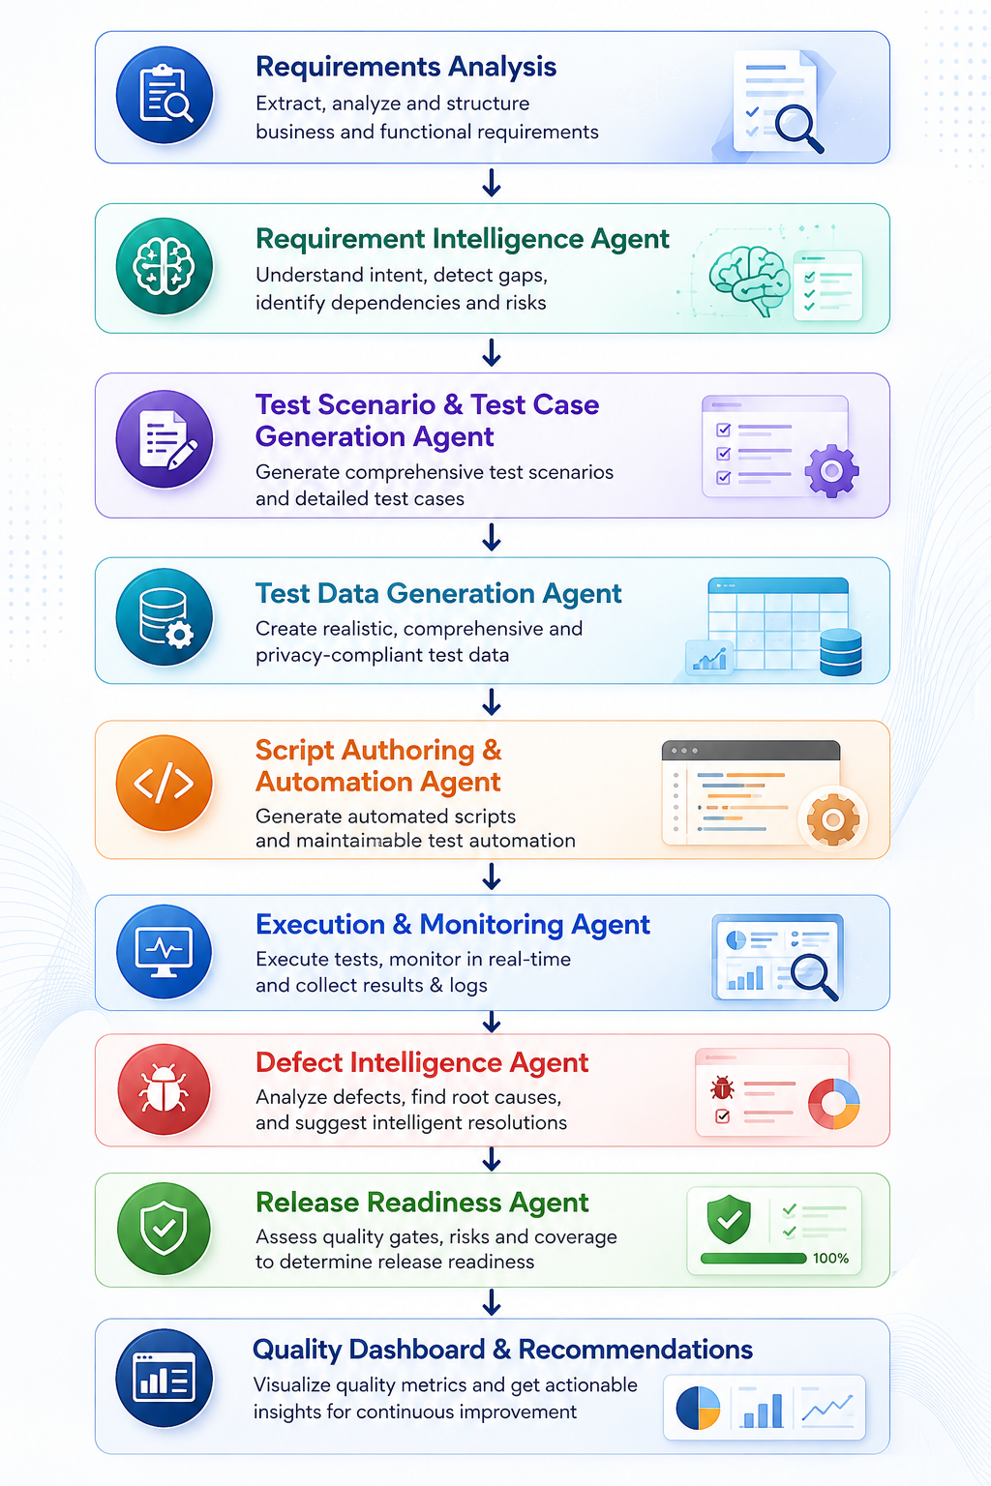
Functional Overview
End-to-End AI-Driven STLC Workflow
The proposed framework automates and coordinates each stage of the Software Testing Life Cycle through specialized AI agents.

Slide 9
Evaluation Methodology
Evaluation Objectives
Assess the effectiveness of the proposed multi-agent framework across the STLC.
Comparison Baseline
Manual QA process
Existing QA automation tools
Proposed AI-driven multi-agent framework
Evaluation Metrics
Automation effort reduction
Requirement-to-test traceability
Test coverage
Defect detection effectiveness
Execution time
User satisfaction
Validation Dataset
Existing organisation source projects
Open-source projects
Public defect repositories

Slide 10
Benefits and Challenges
Expected Benefits
Reduced Manual Effort
Automates repetitive QA activities across multiple STLC phases.
Improved Test Quality
Enhances requirement traceability, test coverage, and consistency.
Earlier Defect Detection
Identifies defects and potential quality risks earlier in the development lifecycle.
Intelligent Decision Support
Provides AI-driven insights for defect analysis and release readiness.
Scalable Multi-Agent Architecture
Supports modular expansion by integrating additional specialized agents.

Slide 11
Benefits and Challenges
Implementation Challenges
LLM Reliability
Ensuring consistent and accurate AI-generated outputs.
Cross-Agent Coordination
Managing communication, validation, and synchronization between multiple agents.
Enterprise Integration
Integrating with existing DevOps tools such as Jira, GitHub, Jenkins, and CI/CD pipelines.
Security & Privacy
Protecting organizational data while using enterprise AI services.
Performance & Scalability
Maintaining low latency and efficient orchestration as workload increases.

Slide 12
System Architecture/Flows

Slide 13
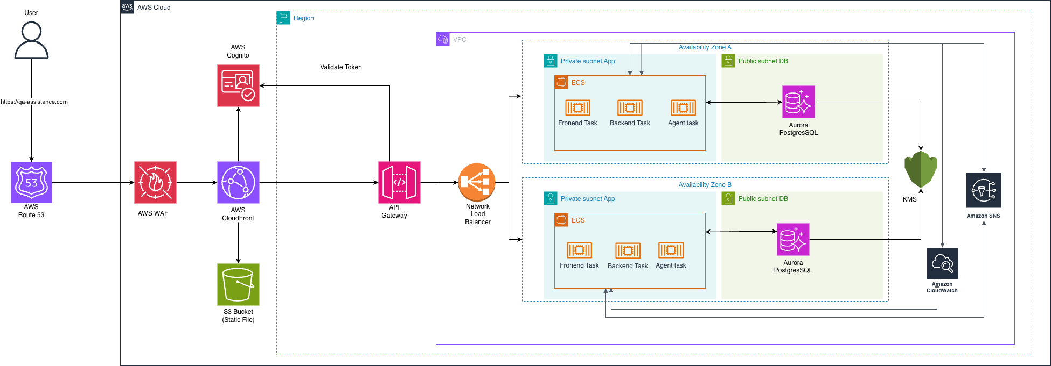
System Architecture

Slide 14
Architecture Overview (Orchestrated Agents)
Central Orchestrator Agent manages flow, validation, and traceability
Key Specialized Agents:
Requirements Agent → Converts business requirements and user stories into structured test intents.
Test Generation Agent → Generates test scenarios, test cases, and intelligent test data.
Script Authoring Agent → Creates automated test scripts with self-healing capabilities.
Execution & Monitoring Agent → Executes tests and captures real-time diagnostics and
    performance insights.
Defect Intelligence Agent → Detects, analyzes, and clusters defects for faster root-cause identification.
Release Readiness Agent → Evaluates quality metrics and produces release readiness scores.

Slide 16
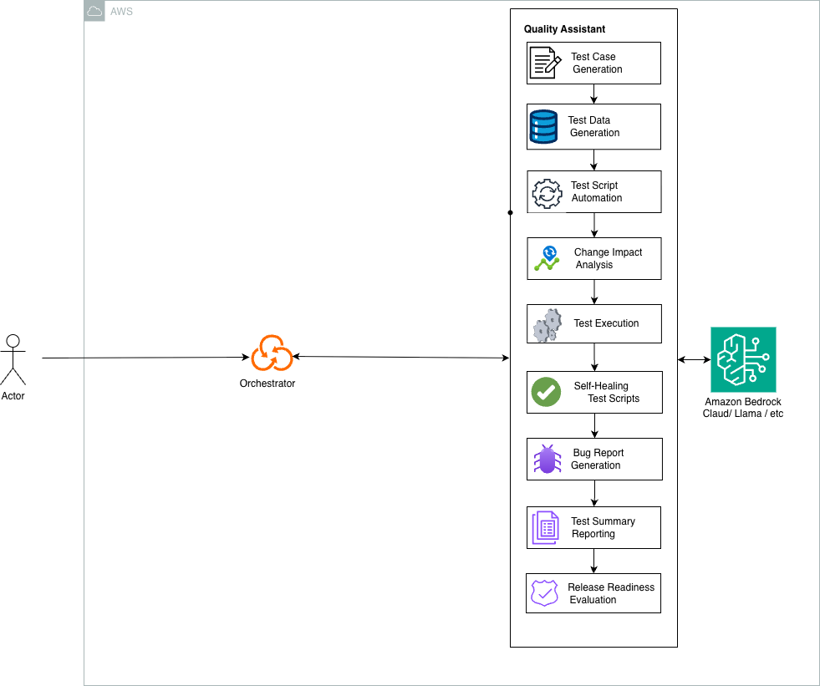
Agentic flow

Slide 17
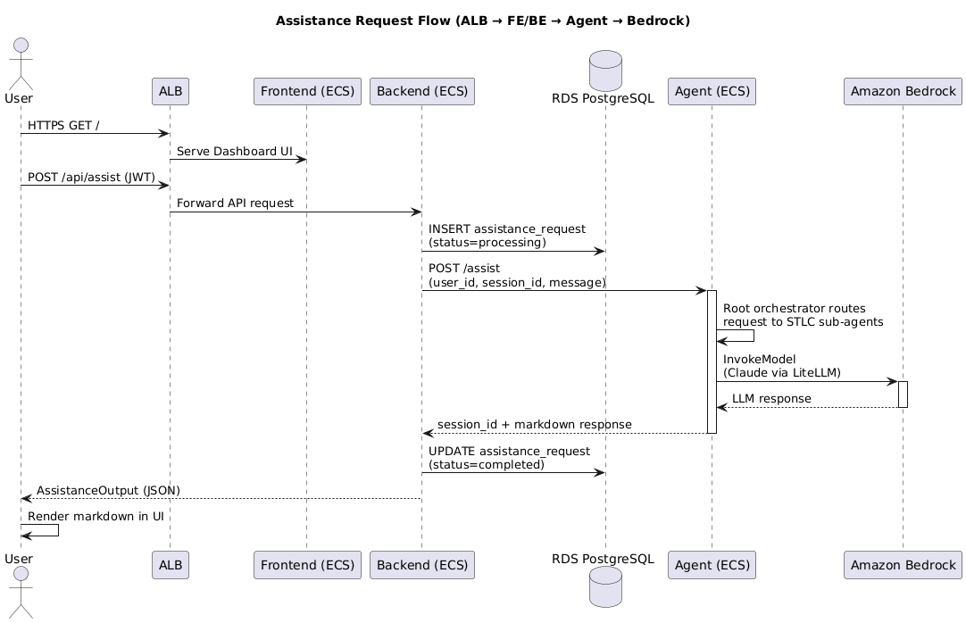

Slide 18
Future Work
Planned Work Before Final Evaluation
Complete End-to-End Multi-Agent Integration
Integrate all specialized agents into a unified and orchestrated STLC workflow.
Ensure validated outputs seamlessly flow between lifecycle phases.
Experimental Evaluation & Performance Analysis
Evaluate the framework using open-source software projects and representative test datasets.
Compare performance with existing QA automation approaches using metrics such as automation effort, test coverage, execution time, and defect detection.
Enterprise Tool Integration
Integrate with tools such as Jira, GitHub, and CI/CD pipelines to demonstrate real-world applicability.
Retrieval-Augmented Generation (RAG)
Enable agents to retrieve contextual information from requirement documents, test repositories, and historical defect data for more accurate and reliable outputs.
Human-in-the-Loop Validation
Introduce approval checkpoints for critical AI-generated outputs to improve reliability, transparency, and user trust.

Slide 19
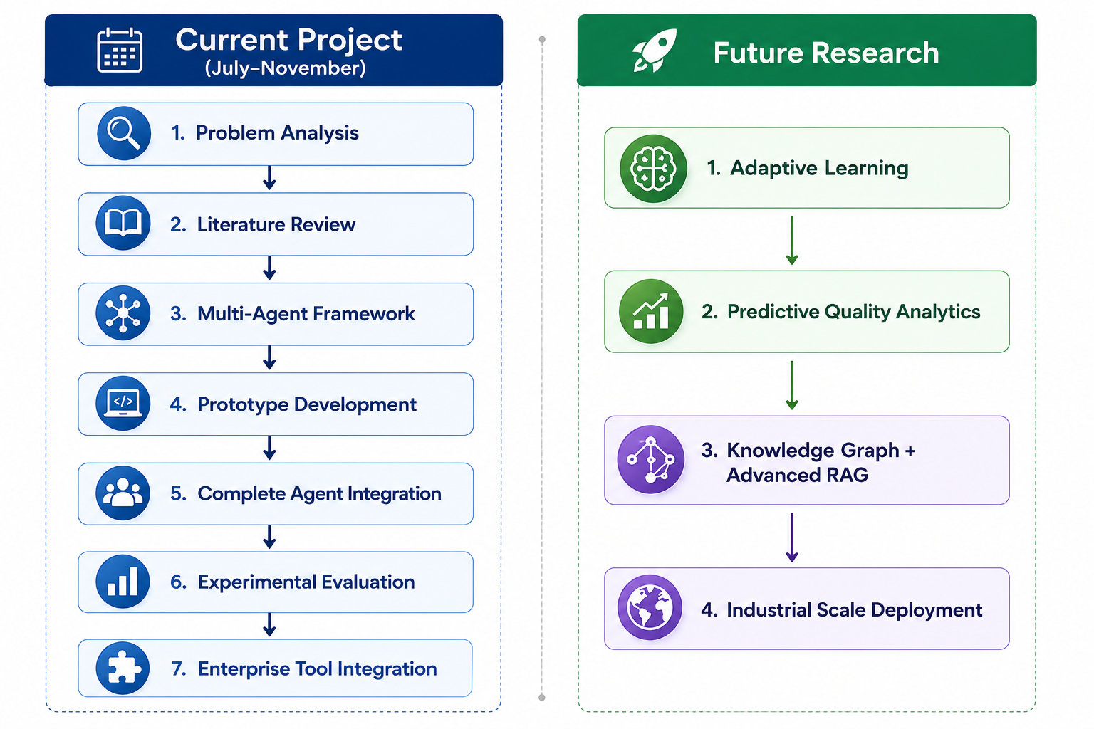
Research Roadmap

Slide 20
Conclusion
Summary of Work
Identified the limitations of existing QA automation, which primarily focuses on isolated testing activities.
Proposed an AI-Driven Multi-Agent Quality Assistant Framework for end-to-end Software Testing Life Cycle (STLC) automation.
Designed a modular architecture with specialized AI agents coordinated through a central orchestrator.
Developed the overall system architecture and implemented the initial prototype using AWS services and Large Language Models.
Demonstrated the framework’s ability to support intelligent requirement analysis, test generation, execution, defect analysis, and release readiness assessment.

Slide 21
Current Project Status
Project Phase | Status
Problem Analysis & Research Questions | Completed
Literature Review & Research Gap | Completed
Framework Design & Architecture | Completed
Initial Prototype Development | Completed
Multi-Agent Workflow Integration | In Progress
Experimental Evaluation & Performance Analysis | Planned
Enterprise Validation & Final Report | Planned

Slide 22
Demo

Slide 23
Thank you!

